Slide 1
Workshop (hidden slide)
Duration: 4hrs
Attendees: ITDM & BDM: Enterprise Architect, Business IT leads, Governance teams, IT Director, Cloud Lead, Operations Lead
Objectives

Slide 2
Best practices for planning and running workshops
1. Be clear on goals and outcomes
2. Decide who will attend
3. Choose the right location
4. Be clear on the agenda
5. Share the follow-up plan
Getting people involved:
Keep group sizes small to encourage participation
Have a mix of different people in the various groups
Be clear on how to capture ideas (shout out or write down)
Get groups to evaluate ideas to narrow down ideas
Overall tips:
Have a facilitator who manages time and process
Start the meeting with some icebreakers
Structure the workshop so that the busiest attendees can attend the most critical parts
As some of the topics may be sensitive related to roles and org structure, try to share examples of where you have seen success in the past.
Source: www.mindtools.com

Slide 3

Cloud Adoption Framework for Azure Strategy – Plan – Ready Workshop
Speaker
Title
Notes:
Welcome slide

Slide 4
Objectives of the Workshop
● Introduce you to the Cloud Adoption Framework, help understand all elements of the transition to cloud
● Assist in building a cloud adoption plan or optimizing current plan
● Build learning path for your teams
● Establish or optimize your Azure cloud environment

Slide 5
Achieve balance. Deliver modernization.
Best practices
Templates
People
Process
Technology
Documentation
Tools
Control & Stability
Speed &
Results
Align—business, people and technology strategy.
Achieve—business goals with actionable, efficient, and comprehensive guidance.
Deliver—fast results with control and stability.

Slide 6
Microsoft Cloud Adoption Framework for Azure
Adopt
Define strategy
Understand motivations
Business outcomes
Business justification
Prioritize project
Plan
Digital estate
Initial organization alignment
Skills readiness plan
Cloud adoption plan
Ready
Azure setup guide
First landing zone
Expand the landing zone
Best practice Validation
Migrate
• Migration guide
• First workload migration
• Expanded scenarios
• Best practice validation
• Process improvements
Innovate
• Innovation guide
• Expanded scenarios
• Best practice validation
• Process improvements
Govern
Methodology • Benchmark
initial best practice • Governance maturity
Manage
Business commitments
operations baseline • Ops maturity

Slide 7
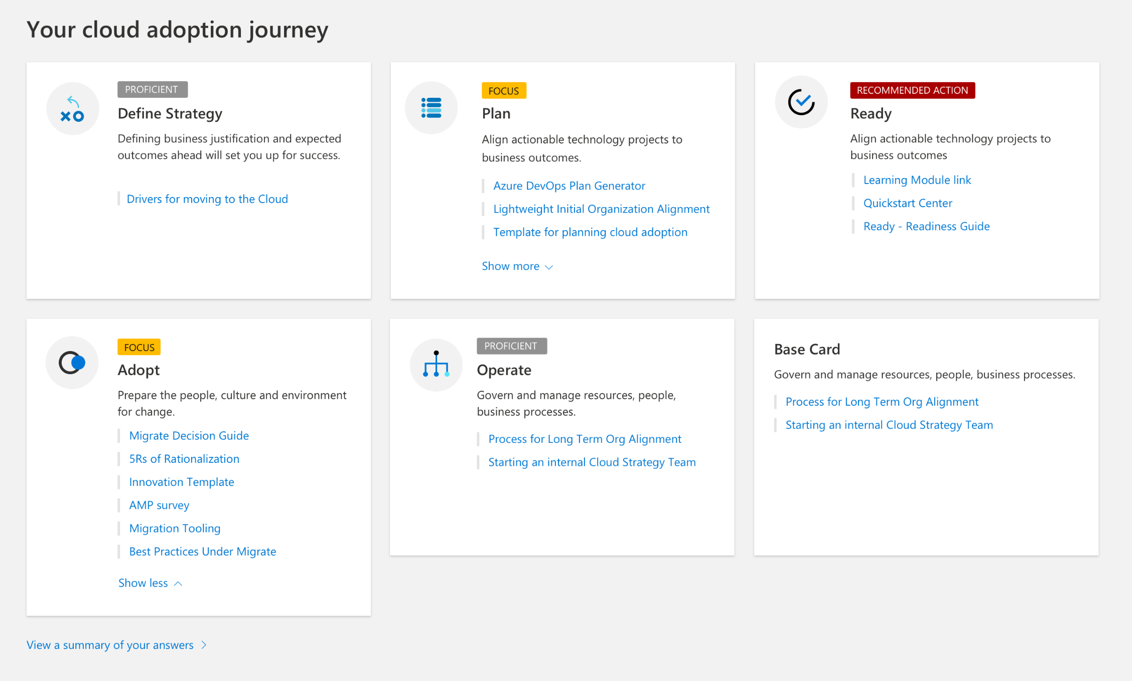
Before we begin…..
Let’s take a few minutes to capture current state of your cloud adoption using the “Cloud Journey Tracker”

Slide 8
Define Strategy
Document your cloud strategy to help stakeholders understand the business outcomes the organization is pursuing by adopting the cloud
1
Motivations
Understand motivations to move to cloud
2
Business Outcomes
Engage stakeholders to document specific business outcomes
3
Business Justification
Develop a business justification that supports your motivations and outcomes
4
Identify First Project
Leverage business and technical criteria to choose your first project

Slide 9




Define Strategy | Understanding your motivation
Innovation triggers
such as scaling to meet market or geographical demands
Critical business events
such as end of support for
mission-critical technologies
Migration triggers
such as cost saving and
operations optimization
Datacenter exit
Mergers & Acquisitions
Reduction in capital expenses
EoS of mission critical technologies
Regulatory compliance changes
Deadlines of data sovereignty requirements
Recent disruptions in IT stability
Cost savings
Reduction in vendor or technical complexity
Optimization of internal operations
Increase business agility
Prepare for new technical capabilities
Scale to meet market or geographic demands
Improve customer experiences or engagements
Transform products or services
Disrupt the market with new products or services
Prepare or build new technical capabilities
Scale to meet market or geographic demands
Engage stakeholders across business and technology to understand your motivations for cloud adoption

Slide 10

Define Strategy | Identify Business Outcomes
Engage different stakeholders and document desired outcomes across these categories
Fiscal outcomes include increased revenue, savings in cost and drive profits
Agility outcomes include time-to-market and provision time to respond to changes
Reach outcomes include global access and data sovereignty
Customer engagement outcomes include meeting customer expectations by reducing cycle times
Performance outcomes include having highly available, global applications
Security & Compliance regulations addressed and implemented
Use the business document template to identify your business outcomes

Slide 11
Define Strategy | Develop Business Justification
Dispel common cloud migration myths such as ..
Mirroring on-premise environment will save money in the cloud
Everything should go into the cloud
I have less visibility and control over my cloud resources
I can run workloads on-prem cheaper than in the cloud
An operating expense model is better than a capital expense model
Cloud is always cheaper
Server costs drive business cases for cloud migration
Public Cloud is not secure
Moving to the cloud is like flipping a switch

Slide 12
Define Strategy | Quantify Business Justification
Develop a justification backed by financial models starting with a basic formula
______________________________________________
Return on Investment(ROI) =
Gain from Investment* – Initial Investment*
Initial Investment
*Initial Investment is the capital expense and operating expense required to complete cloud transformation.
*Gain from investment include revenue deltas and cost deltas.

Slide 13


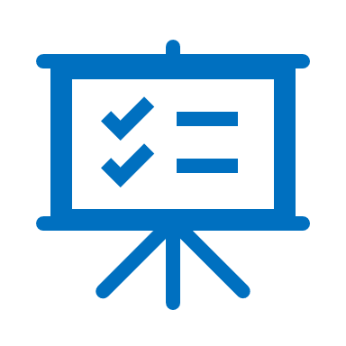
Define Strategy | Identify First Project
Choose the first project to move to the cloud by using a clearly defined criteria and clearly identified outcomes to achieve
First Project Criteria
First Project Expectations
First Project Examples
for each motivation category
Critical business events: Use Azure Site Recovery as a disaster recovery tool, reducing dependencies on disaster recovery assets within the datacenter.
Migration motivations: Start with a noncritical workload and use Azure setup guide and the Azure migration guide for guidance
Innovation motivations: Creation of a targeted dev/test environment can be a great first project.
Should align with your motivations for cloud adoption
Should demonstrate progress towards a defined business outcome
Project is a source of learning.
It might result in production deployments, but it will probably require additional effort first.
The output of this project is a set of clear requirements to provide a longer-term production solution.

Slide 14
Workshop segment #1 Engage stakeholders to define strategy
Example:
What do you expect from your move to the cloud?
What are you moving to the cloud today?
How has your transition to the cloud changed your organization?
What are your short, medium, and long-term objectives?
How are you thinking about dual cloud?
What are the criteria which define where apps or data reside?
What are the risks which you have identified?
What are the next applications and databases which you have identified to move to the cloud?

Slide 15
Plan
Cloud adoption plans convert the aspirational goals of the cloud adoption strategy into actions. It will help guide technical efforts, in alignment with the business strategy.
1
Rationalize Digital estate
Rationalize your digital estate to determine best approach to cloud adoption
2
Initial org alignment
Align governance and cloud adoption to mitigate risks
3
Skills readiness plan
Get your people ready by identifying skills gap and plan
4
Cloud adoption plan
Create an actionable cloud adoption plan that aligns to your business strategy

Slide 16


Plan | Initial Org Alignment
Implementing Cloud adoption plan requires some initial alignment of different stakeholders who will make the plan a reality
Cloud Adoption Team
Cloud Governance Team
Speed vs Control
Create a balance between speed or moving quickly and control or reducing risks by have teams accountable for adoption and governance.
While cloud adoption team is required to execute cloud adoption tasks, governance team ensures processes and controls are implemented

Slide 17
Plan | Rationalize Digital Estate
Cloud rationalization is the process of evaluating assets to determine the best approach to hosting them in the cloud (public or hybrid)
Rationalization can take place using an Incremental approach or ‘Power of 10’ where the cloud strategy team selects the first 10 applications to be migrated which are a mix of simple and complex workloads; (recommended approach)
The output of a rationalization effort is a prioritized backlog of all assets that are affected by the chosen transformation.
Use costing models from your chosen cloud provider to forecast costs for your prioritized backlog; for Azure, we have pricing tools like Azure Migrate, Azure pricing calculator and Azure cost management. Ensure that hybrid is incorporated into the costing models

Slide 18
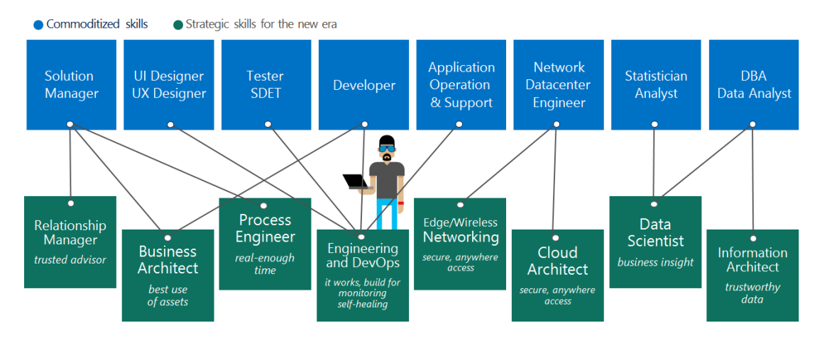
Plan | Skills Readiness Plan
Cloud computing is a technology shift and a new set of skills are required to support cloud solutions
Identify the gaps
Look across teams
Create an org-wide learning plan
1
2
3

Slide 19
Plan | Cloud Adoption Plan
Translate strategy and effort into an actionable cloud adoption plan
Prerequisites: Confirm that all prerequisite steps have been completed before you create your plan.
Define and prioritize workloads: Prioritize your first 10 workloads to establish an initial adoption backlog.
Align assets: Identify which assets (proposed or existing) are required to support the prioritized workloads.
Review rationalization: Review rationalization decisions to refine adoption-path decisions: Migrate or Innovate.
Define iterations and releases: Iterations are the time blocks allocated to do work. Releases are the definition of the work to be done before triggering a change to production processes.
Estimate timelines: Establish rough timelines for release planning purposes, based on initial estimates.

Slide 20
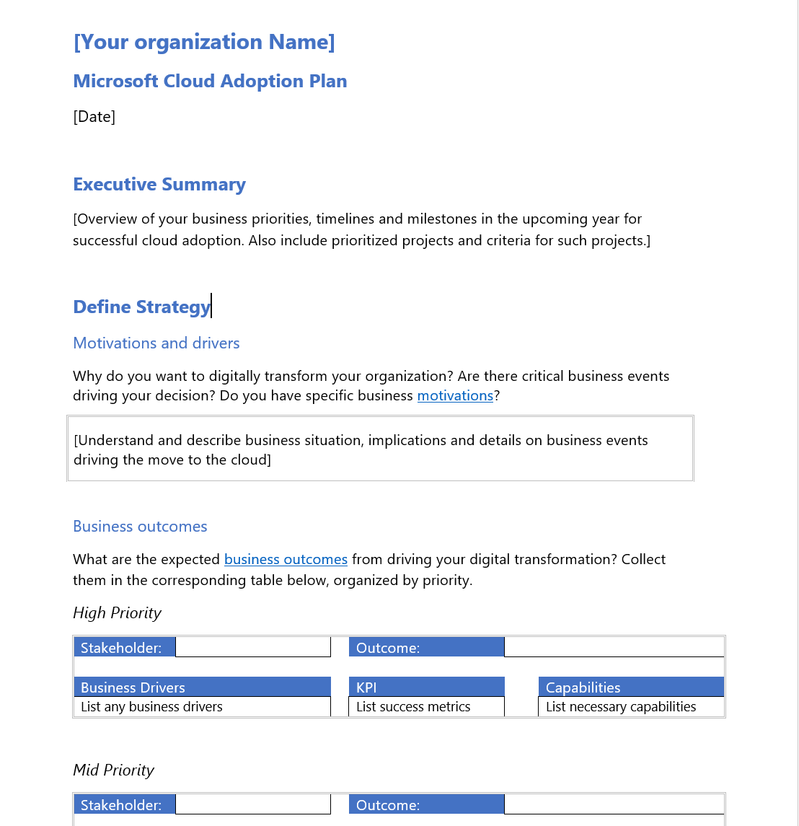
Plan | Cloud Adoption Plan Template
Cloud adoption plan converts the aspirational goals of the cloud adoption strategy into an actionable plan
All the cloud teams leverage the cloud adoption plan to guide technical efforts, in alignment with the business outcomes.
Download the template and get started with creating your plan

Slide 21
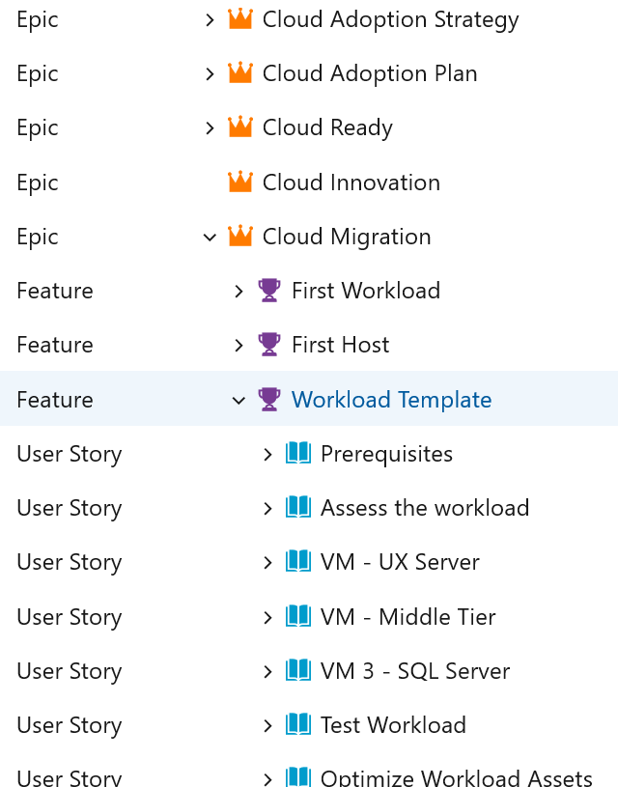
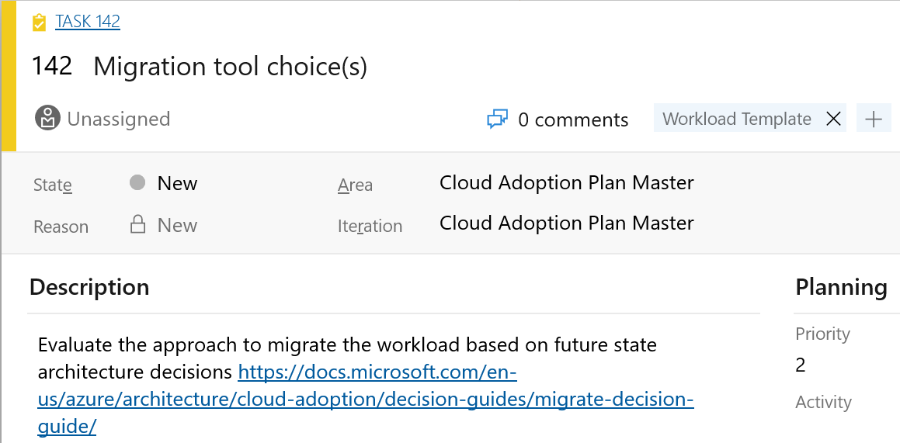
Azure DevOps Cloud Adoption Plan Generator
Leverage Azure DevOps to log and track your cloud adoption plan
aka.ms/adopt/plan

Slide 22
Workshop segment #2 Create your cloud adoption plan
Example:
How are you organizing your people and teams for cloud transformation
Where does accountability reside for application creation and availability
What are the current skills gaps?
How do your people train and skill up?
What is the prioritized list of applications you are moving to the cloud?

Slide 23
Ready
Ready establishes a cloud foundation or adoption target that can provide hosting for any adoption efforts.
1
Azure setup guide
Azure setup guidance in the Cloud Adoption Framework
2
First landing zone
Leverage the Cloud Adoption Framework migrate landing zone blueprint
3
Expand the blueprint
Use the landing zone considerations to enhance the blueprint template
4
Best practices
Validate landing zone modifications against best practices

Slide 24
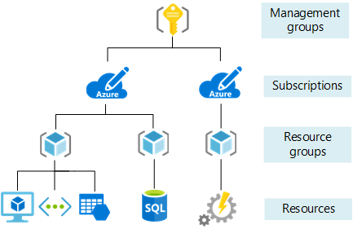
Ready | Organize your Azure Resources
Use the management hierarchies within the Azure platform.
Implement well-thought out naming conventions
Apply resource tagging

Slide 25
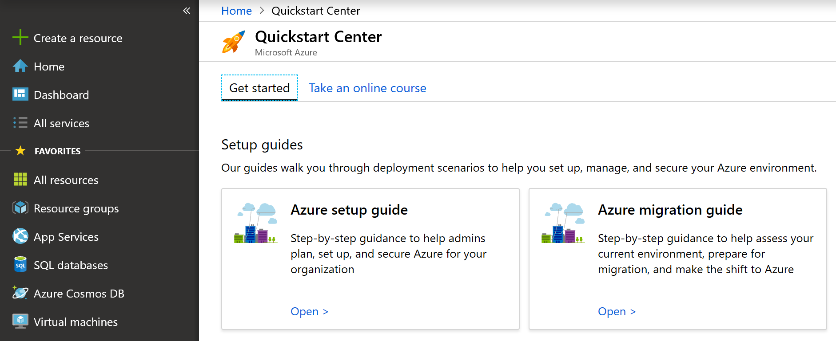
Ready | Azure setup guide
Prepare the cloud environment before building and deploying solutions using Azure services
The Azure setup guide provides guidance on how to organize resources, control costs, and secure and manage your organization helping you create your landing zone in Azure
The guide is also published in the Azure Quickstart Center within the Azure Portal

Slide 26
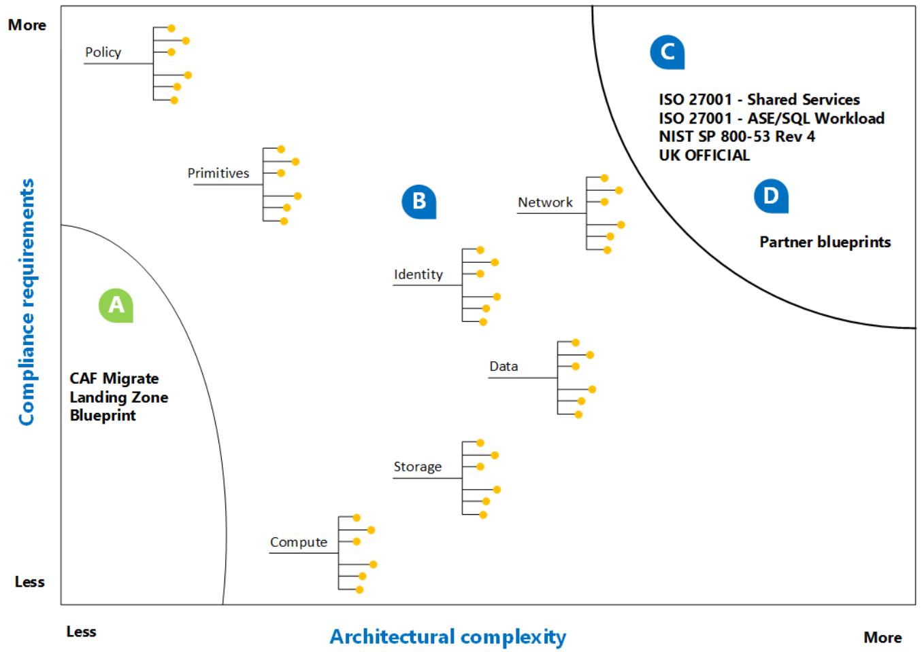
Ready | First Landing Zone
Landing zone is the environment that is provisioned to host workloads being migrated from an on-premises environment into Azure.
The Cloud Adoption Framework migrate landing zone blueprint creates a landing zone which can be updated to meet your specific needs.

Slide 27
Ready | Expand the landing zone blueprint
The considerations for implementing a landing zone fall into three categories
Hosting - decisions need to be made around compute, storage, networking, databases to help create hosting options in the landing zone blueprint
Azure fundamentals - these are the foundational building blocks for organizing resources in the cloud environment.
Governance considerations – applying governance principles on each landing zone

Slide 28
Ready | Recommended Practices
Leverage best practices in Cloud Adoption Framework to help your teams establish and prepare Azure environment. These include guidance in the areas of
Azure fundamentals
Networking
Identity and Access Control
Storage
Databases
Cost Management

Slide 29
Workshop segment #3 Ready your organization and cloud environment
Example:
What is the current Azure environment structure?
Have you defined, naming standards, use of management groups, resource tagging?
How are you defining your data structure? Do you have a master data schema defined?
In your current Azure setup, how are you handling shared services?
Have you established connectivity?

Slide 30
Next Steps
Finalize the Cloud Adoption Plan
Create cloud adoption project through Azure DevOps
Build the Landing zone using Azure Blueprints
Append compliance templates as per business requirements
Workshops to consider:
Build out Governance frame for the business (Governance Workshop)
Ensure you have resiliency in your apps and workloads (Resilience briefing and workshop)

